Slide 1
Our learning report of “Level of Words”
My learning (Mind Map)
Learning outcomes

Slide 2
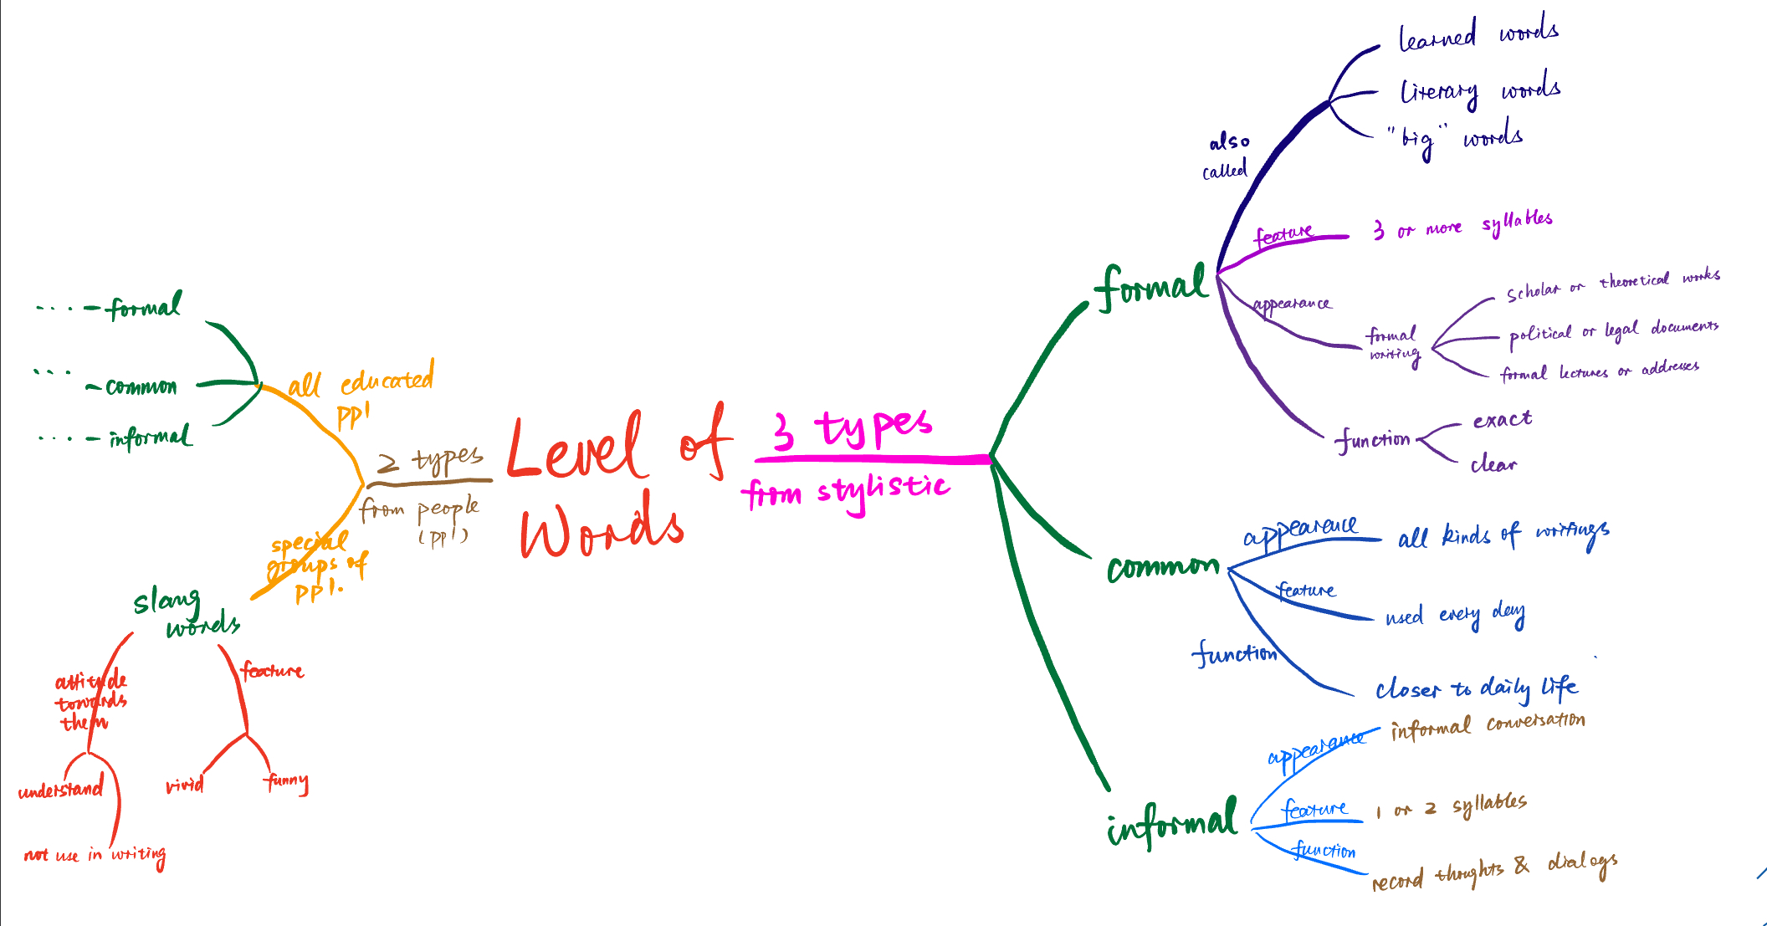
1. My learning

Slide 3
1.1 Stylistic point of view

Slide 4
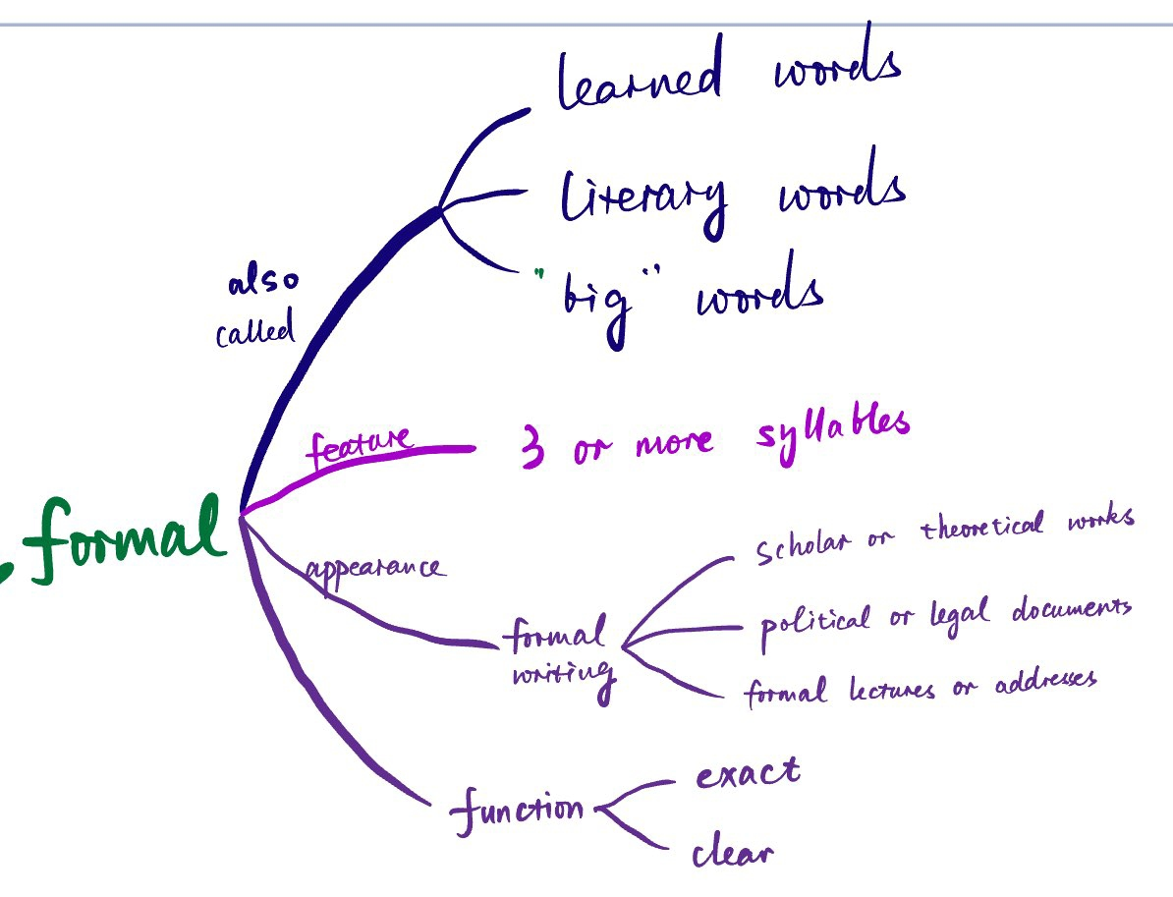
1.1.1 Formal words

Slide 5
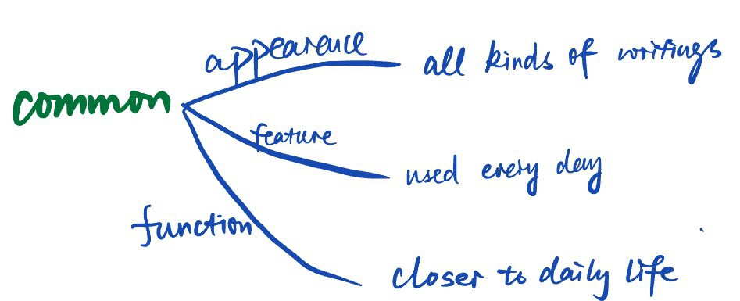
1.1.2 Common words

Slide 6
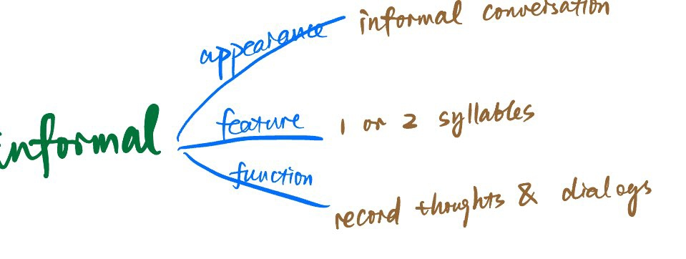
1.1.3 Informal words

Slide 7
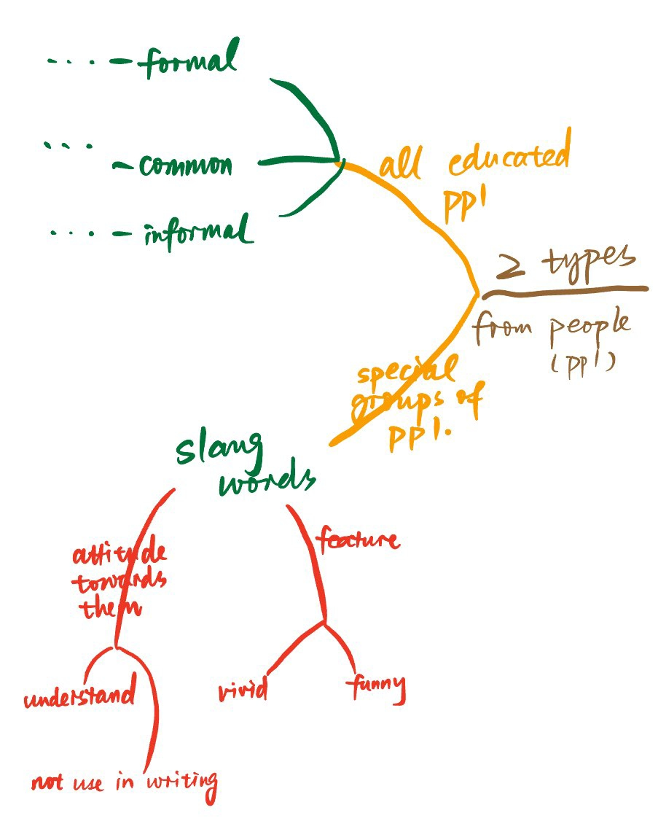
1.2 User point of view

Slide 8
Future use of Level of Words
2. Learning outcomes
Emphasize the key points
Accurate + no misunderstanding
Move people’s heart
Adapt to different occasions
Revising Chinese thinking + cultivating logical thinking

Slide 9
Thanks for listening!
Haochen Han
Group 1

